Slide 1

Tic tac toe
Presentation by :
keerthika s – 950820104022 guided by :
Akshara shreejha k k-950820104003 mrs.m.mahil,m.e.,
Kenishiya s – 950820104023 assistant professor
Banumathi n -950820104007 department of cse
gce, tirunelveli

Slide 2
Introduction
Our project name is Tic-Tac-Toe game. This game is very popular and is fairly simple by itself. It is actually a two player game. In this game, there is a board with n x n squares. In our game, it is 3 x 3 squares. The goal of Tic-Tac-Toe is to be one of the players to get three same symbols in a row - horizontally, vertically or diagonally - on a 3 x 3 grid.

Slide 3
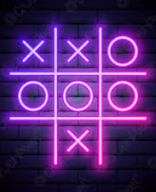
Objective
The objective of this tic-tac-toe game java project is to build a tic tac toe game so anyone can play it without wasting paper. The tic tac toe game is also called the X and O game. The player who succeeds in placing their marks in a diagonal, horizontal, or vertical row is the winner.

Slide 4
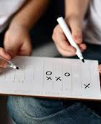
Existing System
Tic-Tac-Toe (or Noughts and crosses, Xs and Os) is a pencil-and-paper game for two players, O and X, who take turns marking the spaces in a 3 x 3 grid.
Time consuming.

Slide 5
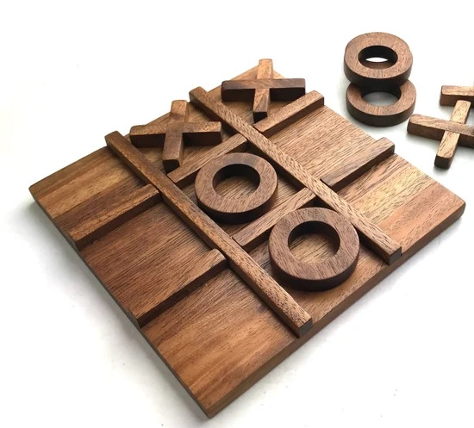
Proposed gaming system
The Tic Tac Toe game is a game for two players, called "X" and "O", who take turns marking the spaces in a 3×3 grid.
The Tic Tac Toe is a great way to pass your free time.
This game can implement both the opponent and computer based gaming.
Can restart the game at same interface without compiling again.

Slide 6
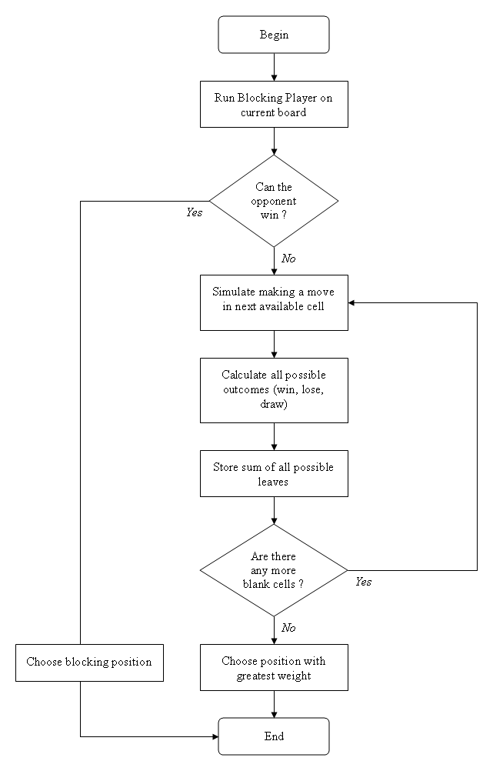
Flowchart

Slide 7
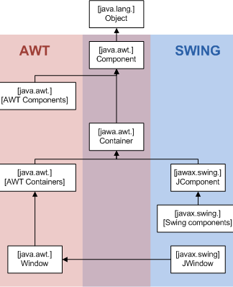
Packages
Swing and AWT(abstract window toolkit)
Swing application used to develop GUI library
AWT used to create graphical interface object, such as buttons, scroll bars, window etc.
In this program we have used JFrame items like ItemListener, ActionPerformed etc.

Slide 8
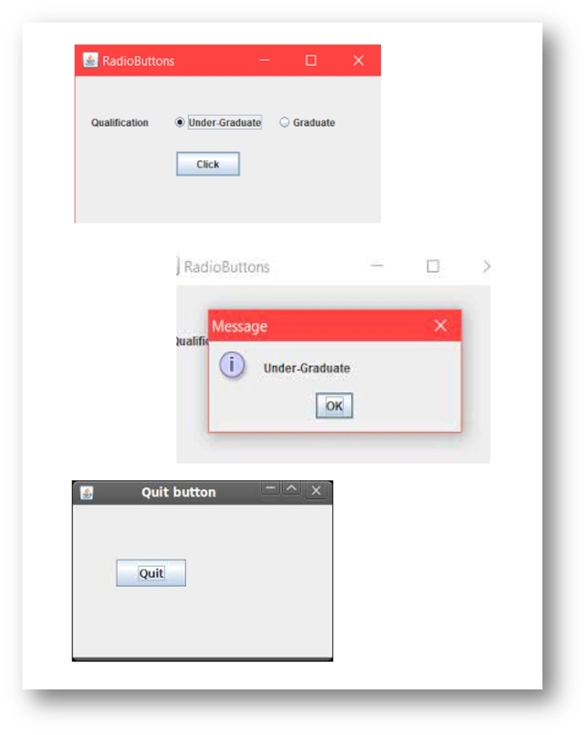
Components
Setting button for 9 boxes to print symbol of two players on alternative move this button will take pictures as result.
We have created a interface where it shows radio button to select whether the player want to play with computer or friend.
Used JOptionPanel to print message after the match end as user won or computer or draw.
Also use button to represent restart for playing again and again without running command prompt again.

Slide 9
Algorithm used is minimax()
Mini-max algorithm is a recursive or backtracking algorithm which is used in decision-making and game theory. It provides an optimal move for the player assuming that opponent is also playing optimally.
Mini-Max algorithm uses recursion to search through the game-tree.
Min-Max algorithm is mostly used for game playing in AI. Such as Chess, Checkers, tic-tac-toe, go, and various tow-players game. This Algorithm computes the minimax decision for the current state.
In this algorithm two players play the game, one is called MAX and other is called MIN.
Both the players fight it as the opponent player gets the minimum benefit while they get the maximum benefit.
Both Players of the game are opponent of each other, where MAX will select the maximized value and MIN will select the minimized value.
The minimax algorithm performs a depth-first search algorithm for the exploration of the complete game tree.
The minimax algorithm proceeds all the way down to the terminal node of the tree, then backtrack the tree as the recursion.

Slide 10
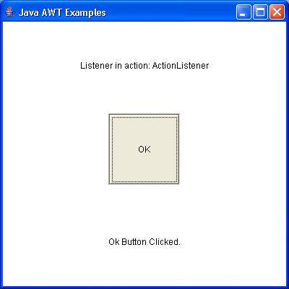
Methods
Public void showButton(): This is used to show button to show X and O .
Public void check(int num): This is used to find whether the player won or lose.
Public void complogic(int num): This method is used for setting computer logic.
Public void itemStateChanged(ItemEvent e):
Invoked when an item has been selected or deselected by the user. The code written for this method performs the operations that need to occur when an item is selected (or deselected).
Public void actionPerformed(ActionEvent e): Called just after the user performs an action

Slide 11
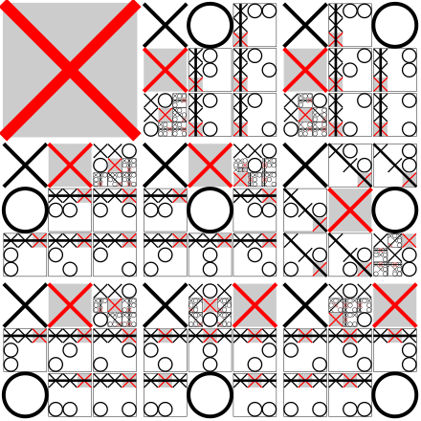
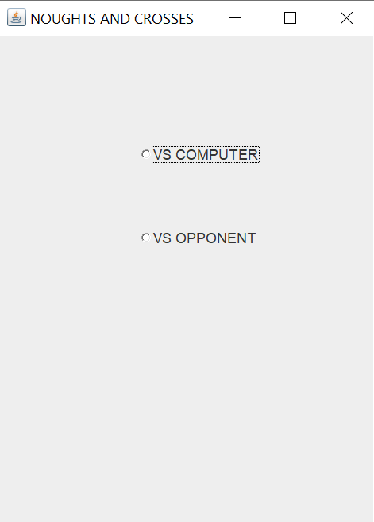
Output

Slide 12
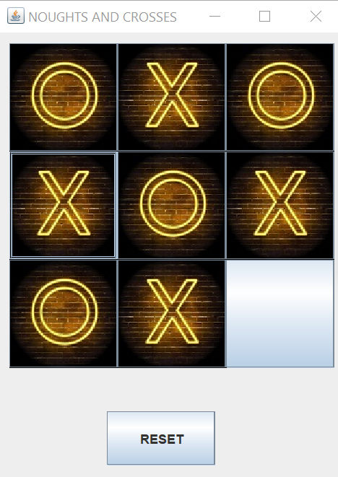
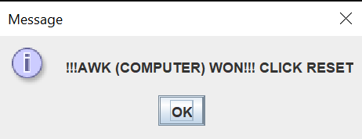
Output : If Computer Won

Slide 13
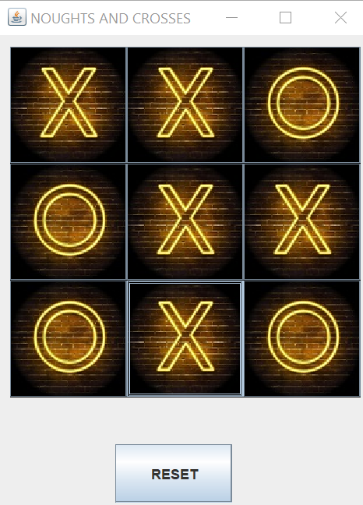
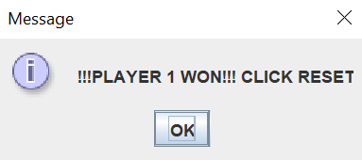
Output : If player1 Won

Slide 14
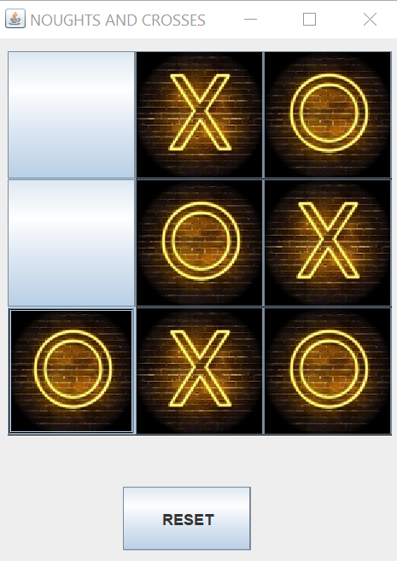
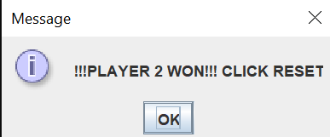
Output : If player2 Won

Slide 15
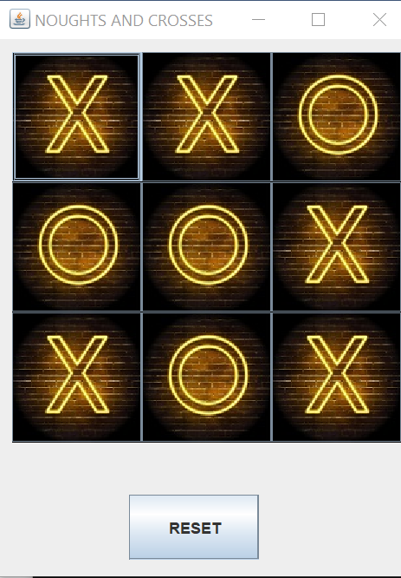
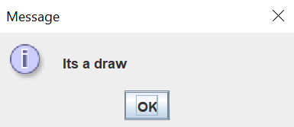
Output : If Draw

Slide 16
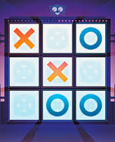
Result
To improve the concentration
To improve hand-eye coordination.
Encourage better social interaction by better collaboration way.

Slide 17
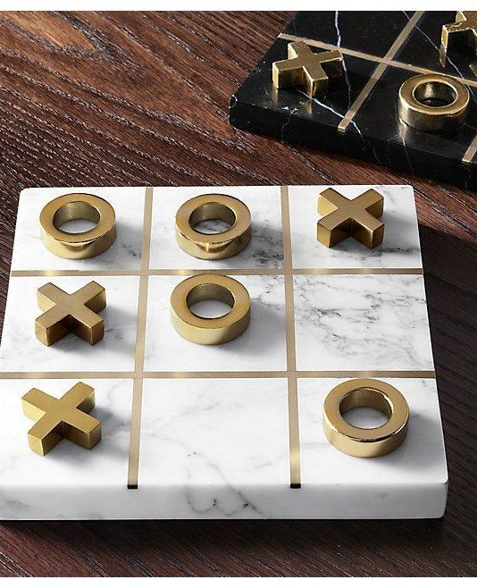
Conclusion
The tic tac toe game is most familiar among all the age group. Intelligence can be a property of any purpose driven maker. This basic idea has been suggested many times. As algorithm of playing tic tac toe has been presented and tested that works in efficient way. Overall the system works without any bugs.

Slide 18


